Slide 1





Ecolution
Team SORTED
A Green Business Case Competition
Devesh Sinha Mohit Kiradoo Kajal Gupta
T. A. Pai Management Institute

Slide 2


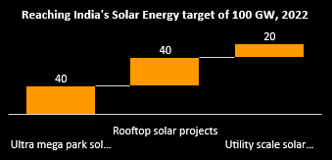
Solar Power Market
Potential
Market Mapping
Overview of Rooftop Solar
Marketing Strategy
State wise Policy Evaluation
Implementation Challenges
Business Models
38%
Solar Power in Renewable Energy Generation
37.31%
Estimation of year-on-year growth rate of 2022
The market is fragmented with several players occupying the market share
$240.42 bn
Market size Growth
52 GW
India's cumulative installed solar capacity
8.9 GW
Total Market Size of India Solar Rooftop
15%
Current CAGR for the Solar Rooftop Industry
Approximate Solar Potential in India
Total Land Area (sq km) | 3,287,590
# of sunny days | 200
Unit potential from 1 sq m | 4kWh/day
Conversion efficiency | 15%
1 sq km(Mn units per year) | 120
0.5% of land used (in sq km) | 16,438
Potential units (in billions) | 1,972
Overall, the market has a growing potential and is a good opportunity for ONergy to expand business in the Rooftop Solar segment into new territories

Slide 3
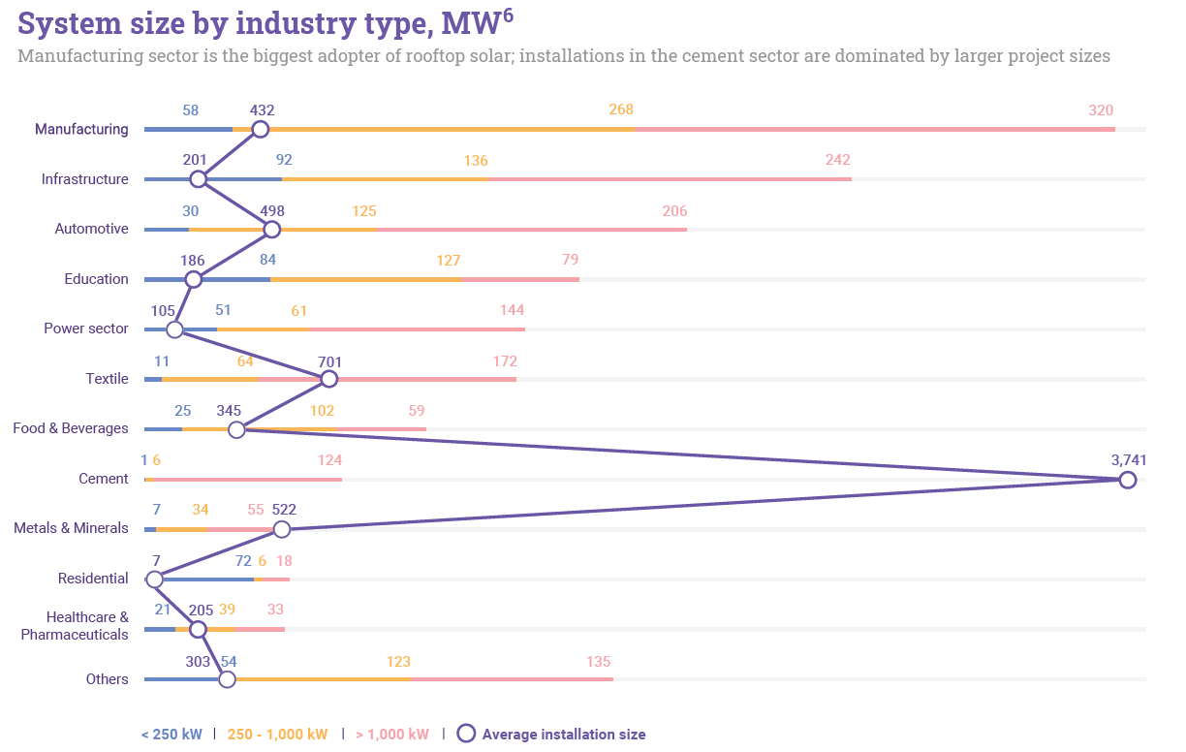
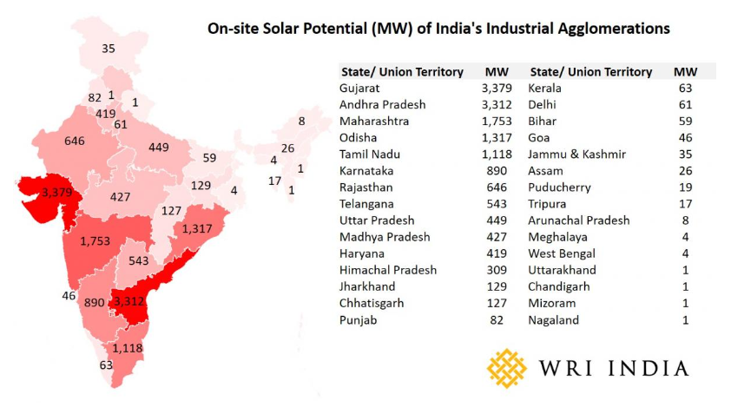
Solar Power Market
Potential
Market Mapping
Overview of Rooftop Solar
Marketing Strategy
State wise Policy Evaluation
Implementation Challenges
Business Models
213
15
Operating SEZs in Eastern & North-Eastern India
1080
Megawatts (MW) of on-site solar power potential
Operating SEZs
As per the mandate issued by Central Ministry of Commerce and Industry (MoCI)
Only 50% can comprise the actual factory area
10.5% of the total core industrial area suitable for on-site solar power. Exploiting this potential for commercial purpose, could support at least 33% of the
nation’s 40 GW rooftop solar target.
The top 3 industries which ONergy should focus in the new territories are: Manufacturing, IT & Iron and Steel.

Slide 4







Solar Power Market
Potential
Market Mapping
Overview of Rooftop Solar
Marketing Strategy
State wise Policy Evaluation
Implementation Challenges
Business Models
2008
Jawaharlal Nehru National Solar Mission (the Solar Mission) launched under Government of India's National Action Plan on Climate Change (NAPCC)
100 GW
solar installations by 2022
40 GW
rooftop solar
The Solar Mission stressed on need for widespread diffusion of RE technologies:
to realize the opportunity for enhancing India's energy security,
reducing greenhouse gas (GHG) emissions,
by tapping the spread availability and potential of solar resources in the country
National and state governments
Utilities
Investors
Developers
Private and public-sector organizations
· Capital subsidy as well as incentive-based schemes for residential and institutional consumers by the Ministry of New and Renewable Energy (MNRE)
· Net and Gross Metering Regulations for 29 states and seven union territories
· Streamlined interconnection guidelines for accommodating rooftop solar generation into the grid infrastructure by DISCOMs or utilities
· More than USD 1,470 million in concessional lines of credit has been raised by the government with assistance from MFIs
6GW
Potential of 6 GW of rooftop installations identified
500MW
Capacity initiated for tendering by Solar Energy Corporation of India (SECI)
Internal targets set by large PSUs like Indian Railways, IOCL
Current Issues
17% increase in Average cost of a rooftop solar system in FY22Q1 compared to the same period last year
Reduction in Overall project margins due to the rise in
component prices,
advent of basic customs duty (BCD),and
hike in goods and services tax (GST)
There is a market opportunity of 1.1 GW of RTS for ONergy in the Eastern and North-Eastern region whereas the cost of installation and margin have reduced.

Slide 5
Solar Power Market
Potential
Market Mapping
Overview of Rooftop Solar
Marketing Strategy
State wise Policy Evaluation
Implementation Challenges
Business Models
State Rooftop Solar Attractiveness Index(SARAL) is a tool which ranks all states based on the below mentioned set of parameters that are critical for accelerating rooftop solar deployment
Evaluating policy conduciveness using SARAL state scores across five broad drivers
Ranking | States | SARAL Score | Robustness of policy framework | Effectiveness of policy work/implementation | Investment climate | Consumer Experience | Business ecosystem | States Conduciveness
14 | Odisha | 39.44 | 25.00 | 46.23 | 40.99 | 45.94 | 31.15 | Orissa is actively looking to invest in ensuring that power 24x7 is delivered and solar has been looked at as an important prospect in that regard
19 | Assam | 29.00 | 62.50 | 13.04 | 11.80 | 25.90 | 40.61 | -
21 | Sikkim | 22.80 | 25.00 | 13.75 | 11.80 | 34.04 | 30.72 | By the year 2022, Sikkim has been set a target of 86MW of grid-connected power by the year 2022 as a part of the National Solar Mission.
22 | Arunachal Pradesh | 21.58 | 33.33 | 11.15 | 11.80 | 24.82 | 32.94 | -
24 | Nagaland | 20.46 | 25.00 | 13.73 | 11.80 | 27.75 | 24.29 | Power Purchase Agreement (PPA) being signed with a Hyderabad-based independent power producing company to set up the first greenfield solar power project of 20MW in the state.
26 | Mizoram | 20.28 | 20.83 | 16.24 | 11.80 | 31.99 | 13.64 | Net metering policy has been put in place so that any consumer who wants to go solar can feed back extra power they generate to the grid
27 | West Bengal | 19.39 | 20.83 | 13.10 | 14.72 | 17.35 | 44.88 | A new policy is expected in West Bengal to the state achieve the target of 4,500MW of solar power by the year 2022
28 | Manipur | 19.31 | 25.00 | 6.16 | 11.80 | 33.39 | 18.23 | Net Metering laws have been formulated and put in place. Also planning for newer rooftop plant is in order to push rooftop solar in Manipur
29 | Tripura | 17.66 | 27.08 | 3.64 | 11.80 | 24.33 | 27.52
30 | Meghalaya | 17.59 | 25.00 | 3.75 | 11.80 | 28.21 | 20.93 | Power has been proposed to setup a 10MW which would see an investment of 150 crores. The location for the plant has been set at Ri-Bhoi and West Garo hills..
Robustness of policy framework
Effectiveness of policy support implementation
Investment climate
Consumer experience
Business ecosystem
The top 3 states where policies are most conducive to ONergy are: Odisha, Assam & Sikkim.

Slide 6






Solar Power Market
Potential
Market Mapping
Overview of Rooftop Solar
Marketing Strategy
State wise Policy Evaluation
Implementation Challenges
Business Models
High upfront and transaction costs
High off-taker risks (in RESCOs)
Performance risks in CAPEX
Limited availability of finance from mainstream financial institutions
Lack of standardized procurement processes
Limited consumer awareness
Challenges faced by Developers
Challenges faced by Utilities
1
High degree of customization required for each project.
Consumers are now evolving to self-generating prosumers who can distribute energy to others directly or through the grid.
2
Several mainstream banks have yet to develop their capacity to analyze and finance RTS.
Rapidly falling costs of renewable energy have led to potential loss of high value customers
3
Considerable issues relating to contractual and payment risk for the developer
Low appetite for rate increases by consumers, grid maintenance, modernization, resiliency and security
4
FIs are unwilling to lend for smaller scale customers with poor credit, hence a vast majority of customers get excluded
Large-scale incorporation of new types of demands on their networks, adding to the technical & business model challenges.
5
Lack of reliable agencies that certify installations
Awareness of RTS within utility staff is minimal. There is also a lack of standardized interconnection processes.
Lending ecosystem and dwindling costs in RE might pose major challenges for ONergy during implementation of their business model.

Slide 7

Solar Power Market
Potential
Market Mapping
Overview of Rooftop Solar
Marketing Strategy
State wise Policy Evaluation
Implementation Challenges
Business Models
Proposed flow for ONergy to execute an effective marketing strategy for the new markets
Marketing strategies for different stages of the funnel
Identification of business goals
Stating marketing objectives at broad
Extensive market research
Potential customer profiling
Competition mapping
Value proposition with 7 P’s
Development of marketing strategies according to customer journey
Testing of different ideas
Feedback and improvisation
Awareness – Targeted cold emails and tele calling referring to client’s pain points, Quora/Reddit answers, Social media marketing, Case studies/testimonials on website and Participation in solar energy summits/seminars
Interest – Sending content related to rooftop solar panels (not the product), organizing guest seminars and inviting prospects there, Focus on FAQ pages and newsletters
Evaluation – SPIN framework questions (Situation, Problem, Implication and Need Pay off) to understand more about the lead, Video testimonials, Emphasize on Trust badges and Product comparison
Engagement – Product tour or walkthrough, Live demo, Engaging content on benefits of solar rooftop and why our product is best through Emails, Personalization and Special discounts
Mandatory Checkboxes before implementing any marketing strategy
PESTEL Analysis for a clear understanding of the external environment
PERCEPTUAL MAP to bring out the value proposition efficiently
NEED Analysis to understand the potential customer pain points
Purchase – Professional implementation, Proper paperwork and last but not the least service assurance
After Sales Service – Most of the companies overlook this stage but it is most important to have word of mouth, repeat sales and brand name
ONergy should focus mainly on 3 pillars of the marketing mix: Product for quality assurance, Price for the current market nature and Process to maintain profitability.

Slide 8
Solar Power Market
Potential
Market Mapping
Overview of Rooftop Solar
Marketing Strategy
State wise Policy Evaluation
Implementation Challenges
Business Models
Utility-driven business models can play a transformative role in development of India's rooftop solar market, by increasing its participation in deployment of RTS by adopting a facilitation or investment-based approach, hence helping the country achieve its solar energy targets. Suggested 4 utility-centered models:
1. Anchored-procurement
Utilities assist consumers in procuring RTS systems (self-owned CAPEX model)
Facilitated Procurement Model
EPC Contractor Model
Utility as single point stop for the consumers, facilitates procurement and installation of RTS through a third party who has been wetted and evaluated by the utility.
Process:
Utility enrolls consumers interested in setting up rooftop solar projects
Signs a standard Project Management Services agreement (services offered by the utility and developer; the outline of bidding process; templates of the EPC agreement; and terms and conditions)
Competitive bidding process for the aggregated capacity on behalf of consumers
Successful bidder chosen;
Consumers sign an EPC agreement with the selected developer(s)
Facilitation fee collected from developer(s)
In this model, Utility acts as a developer as well.
Process:
Utility directly enter into an EPC agreement with the consumers for the design, supply, engineering, installation and commissioning
Option to enter into a back-to-back EPC agreement with a project developer
Competitive bidding process to identify developer(s) for developing the aggregated capacity
Customer Pays
Utility
Vendor Payment
Utility
Facilitation Fee
Back to Back Agreements
Consumers
Mandate for Vendor Selection
Facilitation Agreement
Vendors
Consumers
EPC Agreement
EPC Agreement
Vendors
EPC Agreement
Benefits:
Better contract enforceability
Enhanced quality control
Timely execution
Can earn a margin (difference between the value of back-to-back EPC contracts on each project)
Better control in the project development process(through back-to-back EPC contracts with consumer and developer)
Benefits:
Economics of scale
Better quality of systems due to utility defined standards and inspections
Improved O&M services
Faster installation and lower transaction costs
Lower payment risks to vendors and suppliers
Lower cost due to aggregation with on-time execution and improved O&M services would help build economies of scale for ONergy.

Slide 9

Solar Power Market
Potential
Market Mapping
Overview of Rooftop Solar
Marketing Strategy
State wise Policy Evaluation
Implementation Challenges
Business Models
2. On-Bill Financing
Preferred model for residential consumers interested in developing rooftop solar projects through self-owned model
Three stakeholders involved: the consumer, the lender and the utility
Utility assists the consumers by facilitating access to finance, acts as the go-between the consumer and the financial institution
Low cost of financing due to economies of scale, preferential rates available to the consumer, lower risk profile and lower transaction costs
Utility collects, preferably through the electricity bill, equated monthly installments (EMIs) on the loans taken by consumers
EMIs are passed on to the financial institution by utility for a small service fee
Option to tie up with their preferred banking partners for effective implementation
Collects Payments from Consumers
Utility
Pass Payments from Consumers Collect Fee for Facilitation and Payment Assurance
Consumers
Developers/ Lendors/RESCO
Services
Clubbing this with anchored procurement model, will give consumers access to easy finance, reliable selection of vendors selected through a bidding process, & on-time installation of quality systems.
3. Utility as Super-RESCO
Utility acts as a Super-RESCO
Utility owns and invests, or procures rooftop solar power from third party developer(s) and supplies power to the consumer
Consumer does not own the system, enters into a long-term Power Purchase Agreement to buy solar power from the utility at a mutually defined price
Generate and sell Electricity from Rooftop System; Lease Rooftops
Utility
Loan
Consumers
PPA
Interest and Repayment
Lendors
Utility invests capital to set up rooftop solar projects on customer premises.
Agreement with consumers to buy the electricity generated, and lease their rooftops, to site the system, to the utility for the useful life of the project (25 years)
Upfront aggregation and procurement of the utility allows significant reduction in costs due to economies of scale
If overall CAPEX is lower than market rates, the cost of generation are reduced, and can be passed on to the consumer.
The utility may subcontract EPC work to other vendors, reducing time delays in interconnection, and hence, the entire transaction can be dealt with by the utility.
Fixed tariff
RESCO-owned RTS systems: The consumers lease rooftops to the utility and the utility sub-leases it to the RESCO
Utility acts as a Super-RESCO but does not set up, operate and own the systems
Utility identifies interested consumers and aggregates the demand but services them through power purchased through interested RESCOs
Power is procured from the RESCO at a mutually agreed price (discovered via bidding process) and is sold to the consumer by including trading charges.
Customer Acquisition, increased payment security and high operational efficiency make these models profitable for ONergy.

Slide 10
Solar Power Market
Potential
Market Mapping
Overview of Rooftop Solar
Marketing Strategy
State wise Policy Evaluation
Implementation Challenges
Business Models
4. Payment Assurance Model
Utility acts as facilitator
Utility neither invests nor owns the system, facilitates between the consumer and other stakeholders (RESCO, developer and lender)
Utility collects payments for electricity generated from third party-owned RTS systems from its clients and pays the roof top developer for a fee.
Utility reduces the payment risk to the developer and attracts financing as well as reduces the cost of finance.
It also helps reduce counter party risk for the lenders and make projects more viable.
This business model can be implemented in parallel with the above discussed business models as well.
Pays EMI for Loan
Utility
Loan Payback
Consumers
Tripartite Agreement
Lendors
Loan
Assessment and applicability of each of the Utility-Centred models
Model | Risk to Utility | Investment Requirement | Transaction Costs | Institutional Capacity Utilisation | Institutional Capacity Building | Returns
Anchored Procurement | Low | Low | Medium | Low | Low | Low
On-Bill Financing | Medium | Low | Low | Medium | Medium | Low
Super RESCO | Medium | High | High | High | High | High
Payment Assurance | Medium | Low | Medium | Low | Low | Low
Assessment of regulatory modalities prior implementation
Regulatory Intervention
Regulated or Un-Regulated Business?
CAPEX approval
Treatment of gains/losses from UBMs
Other regulatory issues?
Allocation of costs/assets?
Rate of RoE
ONergy should make an assessment of the business models based on the stakeholder engagement possible in the pertaining business environment.

Slide 11
APPENDIX

Slide 12
Appendix 1: Role of key stakeholders in Anchored-Procurement Model
 | Consumer | Utility | Vendor | Financer
Procurement Phase | Desires of quality system installed at competitive prices | Engage consumers and vendors to execute back-to-back agreement. Facilitating procurement by aggregating rooftop and selecting EPC vendors through bidding process for execution | Vendors apply for empanelment with utility through a bidding or selection process | Lender scrutinizes the consumer credit history and approves financing
Project Development | Facilitate vendor access to rooftop for systems set up | Facilitation of project execution; Utility can charge facilitation fees in this process | Set up of system as per agreed terms and conditions | Timely disbursement of loan amount as working capital for vendor
O&M Phase | Timely payment for energy services to utility; provide roof access for O&M activities | Acts as collector of payments, passes it on to vendor | Offers quality O&M service and ensure maximum possible generation | Collection of loan repayments from vendor and ongoing monitoring

Slide 13
Appendix 2: Role of key stakeholders in On-Bill Financing Model
 | Consumer | Utility | Vendor | Financer
Procurement Phase | Desires of a quality system installed at competitive prices | Engage consumers and lenders to execute tripartite agreement. Assists lender in evaluating customer loan | Vendors apply for empanelment with utility through a bidding or selection process | Lender scrutinizes the consumer credit history and approves financing
Project Development | Facilitate vendor access to rooftop for systems set up | No role during project development, only facilitate in financing | Set up of system as per agreed terms and conditions | Timely disbursement of loan amount as working capital for vendor
O&M Phase | Timely repayment of loan amount in EMI to utility provide access to roof for O&M-related activities | Conduit of payment to lender | Offers quality O&M service and ensure maximum possible generation | Collection of loan repayments and ongoing monitoring of loan portfolio

Slide 14
Appendix 3: Role of key stakeholders in Super RESCO Model
 | Consumer | Utility | Financer
Procurement Phase | Desires of quality systems installed at competitive prices | Signs agreement with the consumer, avails low-cost finance and procures system components | Lender scrutinizes the utility's credit worthiness, and provides finance to utility
Project Development | Facilitate utility/sub-contractors' access to rooftop for system set up | System set up and interconnection with the grid as per agreed terms and conditions | Lender scrutinizes the utility's credit worthiness, and provides finance to utility
Project Development O&M Phase | Purchases electricity | Owns and run the system. Sells electricity to consumer at agreed tariff and undertakes O&M. Repayment of loan to lender | Collection of loan repayments and ongoing monitoring of loan portfolio

Slide 15
Appendix 4: Role of key stakeholders under Payment Assurance Model
 | Consumer | Utility | Vendor
Procurement Phase | Desires of quality systems installed at competitive prices. Identifies the EPC, and RESCO. Avails finance in case of CAPEX model | Signs agreement with the EPC/RESCO and consumer to receive payment on agreed terms and conditions | Procures system and agrees to provide finance
Project Development | Facilitate EPC/RESCO, the access to rooftop for system set up | - | Sets up the system as per agreed terms and conditions; provides finance
O&M Phase | Receive electricity and pays the utility | Collects and assures timely payment from consumer and pays them to the Developer/Lender/ RESCO | Owns, operates the system; Repayment of loans; Receives repayment

